Slide 1
Introduction to coursework 1.1 and Use Case Analysis
Lecture 5

Slide 2
Requirements
Can be functional
  What the system should do
  e.g. provide a login facility that uses a username and password
Can be non-functional
  Constrains on how the functions are provided
  Username must be longer than six characters
  Software must be written in Java

Slide 3
Use cases
Use → How you use the system
Case → An example
Functional modelling of requirements
Show the external view of the system
  (Do not model internal processes)
Show the system relative to different users of the system

Slide 4
Use Cases
Use-Cases are a scenario based technique in the Unified Modeling Language (UML) which identify the actors in an interaction and which describe the interaction itself.
A set of use-cases should describe all possible interactions with the system.
Sequence diagrams may be used to add detail to use-cases by showing the sequence of event processing in the system (we shall study sequence diagrams later).

Slide 5
Use Cases
In a use-case diagram, an actor is a user of the system (i.e. Something external to the system; can be human or non-human) acting in a particular role.
A use-case is a task which the actor needs to perform with the help of the system, e.g., find details of a book or print a copy of a receipt in a bookshop.

Slide 6
Actors (players)
Anything external to the system which the system interacts with
Can be human
  Customer
  Player (game)
  Driver
Can be non human
  Sensor (smoke detector)
  Payment service (credit cards)
  Geo location
  Robotic arm

Slide 7
Use Cases
The details of each use case should also be documented by a use case description: E.g.,
  Print receipt – A customer has paid for an item via a valid payment method. The till should print a receipt indicating the current date and time, the price, the payment type and the member of staff who dealt with the sale.
    [Alternate Case] – No print paper available – Print out “Please enter new till paper” to the cashier’s terminal. Try to print again after 10 seconds.
An alternate case here is something that could potentially go wrong and denotes a different course of action.

Slide 8
Example - Article Printing Use-Case
Actor
Use case

Slide 9
ATM machine
Actors
  Customers
  Bank staff
  ATM service engineer
Use cases
  Withdraw cash
  Check balance
  Add cash to machine
  Check security video recording

Slide 10
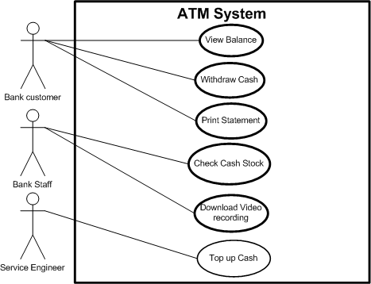
Example - ATM Use Case Diagram

Slide 11
Advanced Use Case Diagrams
We can draw a box (with a label) around a set of use cases to denote the system boundary, as on the previous slide (“ATM system”).
Inheritance can be used between actors to show that all use cases of one actor are available to the other:
Service Engineer
Bank Staff

Slide 12
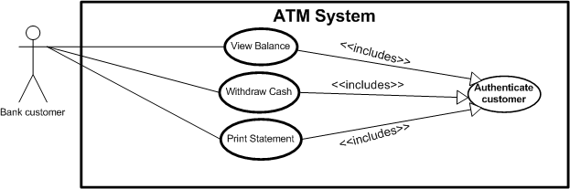
Include Relations
If several use cases include, as part of their functionality, another use case, we have a special way to show this in a use-case diagram with an <<include>> relation.

Slide 13
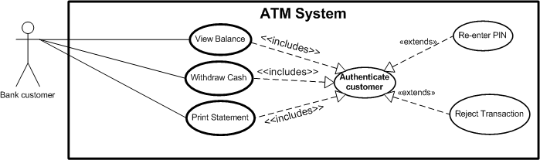
Extend Relations
If a use-case has two or more significantly different outcomes, we can show this by extending the use case to a main use case and one or more subsidiary cases.

Slide 14
In summary
Include
  When the other use case is always part of the main use case
Extend
  When the other use case, is needed as an optional outcome due to certain circumstances/scenarios

Slide 15
A Word on Extend/Include
Note the directions of the arrows in the previous two slides, they are different for each (according to whether a use case “includes” another, or “extends” it).
One of the benefits of UML diagrams is their simplicity and that they can be shown to and worked through with, customers.
This is to some extent lost by using more advanced features like “include” and “extend” relations; they should thus be used with care.

Slide 16
Full use case template
ID
  Short ID (useful for diagrams and reference)
Name
  Full name
Description
  Full description
Pre-condition
  What must be true before the use case can proceed
Event flow
  Flow of behaviour that makes up this use case
Post-condition
  What should be true if the use case successfully completes
Includes
  What other use cases are used
Extensions
  Optional behaviour
Triggers
  What makes this use case happen

Slide 17
Notes about use cases
They do NOT describe internal behaviour
Must describe behaviour with external Actors
But external Actor can be
  External system (e.g. Paypal)
  External hardware (e.g. smoke detector fire alarm)
  External agency (e.g. Police, fire brigade)
So Use cases are always system EXTERNAL behaviour

Slide 18
ATM use case descriptions
ID | UC1
Name | Withdraw cash
Description | Bank customer withdraws cash from machine
Pre-condition | ATM in service
Pre-condition | ATM has sufficient cash stock
Event flow | 1. Include Use case 2 “Authenticate customer” 2. Choose quick cash or enter exact amount 3. Choose receipt option 4. Take cash
Extension points | Use case 4 “Balance too low”
Triggers | Withdraw cash request entered
Post condition
Balanced updated

Slide 19
ATM use cases
ID | UC2
Name | Authenticate customer
Description | Bank customer proves their identity to the ATM.
Pre-condition | ATM in service
Pre-condition | User not authenticated
Event flow | 1. If user already authenticated exit from user case. 2. User enters card and PIN number 3. User re-enters PIN if PIN incorrect
Extension points | Use case 5 “Card stolen” Use case 6 “PIN entry failure”
Triggers | Authenticated service requested
Post-condition | User is authenticated if credentials correct

Slide 20
ATM use cases
ID | UC3
Name | Check balance
Description | Bank customer retrieves a balance for their account
Pre-condition | ATM in service
Event flow | 1. Include Use case 2 “Authenticate customer” 2. Choose onscreen or paper balance
Extension points | None
Triggers | Check balanced requested
Post-condition | None

Slide 21
ATM use cases
ID | UC4
Name | Balance too low
Description | Bank customer cannot make cash withdrawal due to low balance
Pre-condition | None
Event flow | 1. Customer chooses smaller amount or cancels transaction
Extension points | None
Triggers | Cash chosen greater than available balance
Post-condition | None

Slide 22
Next lecture…
Please look at Hotel booking case study
Please prepare this case study problem..

